Slide 1
THE TRAGEDY OF THE COMMONS
GROUP 10

Slide 2
INTRODUCTION
The tragedy of the commons refers to a situation in which individuals with access to a public resource (also called a common) act in their own interest and, in doing so, ultimately deplete the resource.
This economic theory was first conceptualized in 1833 by British writer William Forster Lloyd. In 1968, the term “tragedy of the commons” was used for the first time by Garret Hardin in Science Magazine.

Slide 3
INTRODUCTION CONT’D
This theory explains individuals’ tendency to make decisions based on their personal needs, regardless of the negative impact it may have on others. In some cases, an individual’s belief that others won’t act in the best interest of the group can lead them to justify selfish behavior. Potential overuse of a common-pool resource—hybrid between a public and private good— can also influence individuals to act with their short-term interest in mind, resulting in the use of an unsustainable product and disregard the harm it could cause to the environment or general public.

Slide 4
EXAMPLES OF THE TRAGEDY OF THE COMMONS
1. Overfishing:
When a commonly-owned fishing resource, such as a particular fishing area or a specific fish species, is exploited by multiple individuals or groups without proper regulation, it can lead to overfishing. Each individual or group has the incentive to catch as many fish as possible for their own benefit, even if it ultimately depletes the fish population and harms the long-term sustainability of the resource.

Slide 5
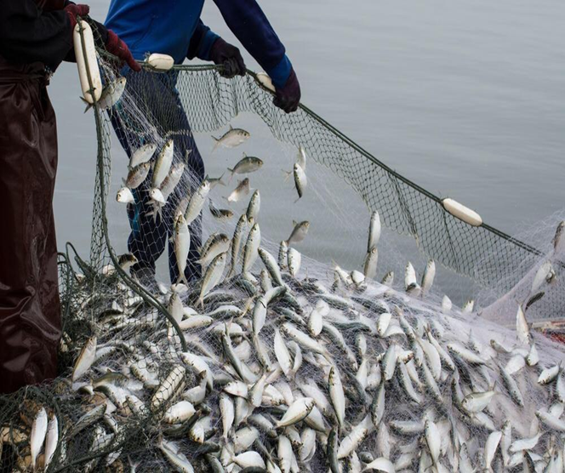
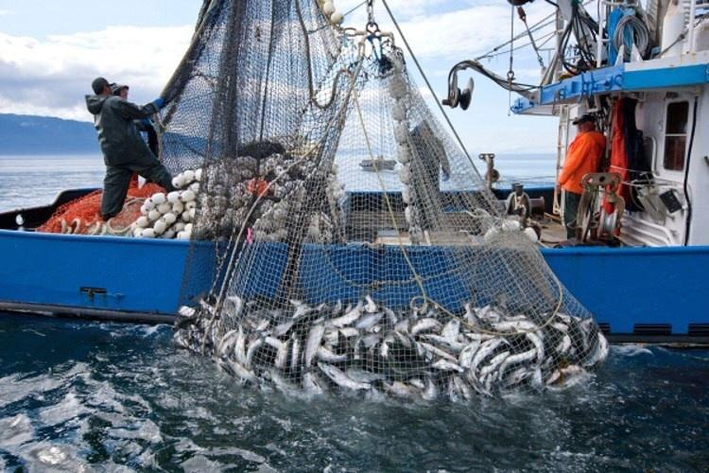
Overfishing
Fig 1 fig 2

Slide 6
EXAMPLES CONT’D
2. Deforestation:
In areas where forests are commonly owned or managed by multiple entities, the tragedy of the commons can occur if there is a lack of proper regulations or enforcement. Each user, whether it's for logging, agriculture, or fuelwood collection, has the incentive to maximize their own gains without considering the long-term effects on the forest ecosystem, including soil erosion, loss of habitat, and climate change.

Slide 7
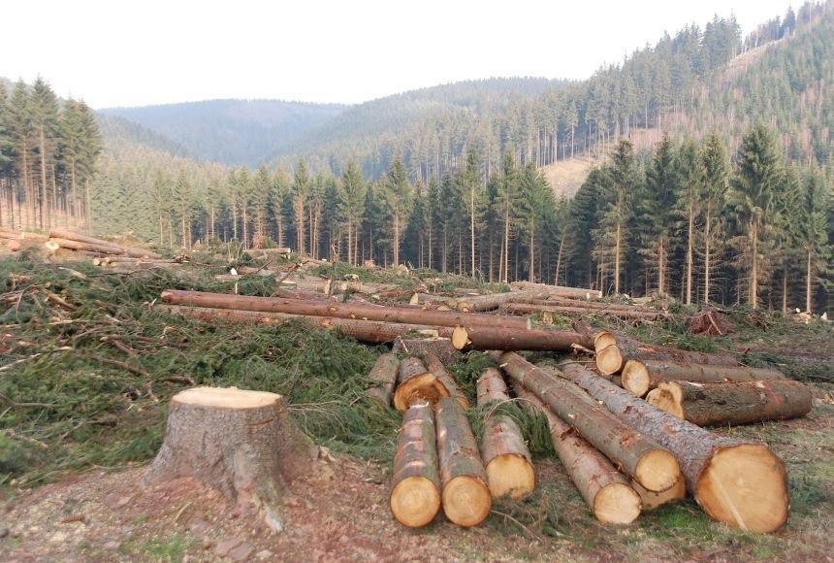
Deforestation
Fig 3

Slide 8
EXAMPLES CONT’D
3. Grazing on communal land:
In some regions, land is shared among multiple herders who allow their livestock to graze freely. This can lead to overgrazing if there are no regulations or if each herder seeks to maximize their own herds' feed without considering the carrying capacity of the land. Overgrazing can degrade the vegetation cover, deplete soil nutrients, and impact the livelihoods of all herders who rely on the shared grazing land.

Slide 9
EXAMPLES CONT’D
4. Coffee Consumption:
While a simple cup of coffee might seem harmless, coffee consumption is a prime example of the tragedy of the commons. Coffee plants are a naturally occurring shared resource, but overconsumption has led to habitat loss endangering 60 percent of the plants' species—including the most commonly brewed Arabica coffee.

Slide 10
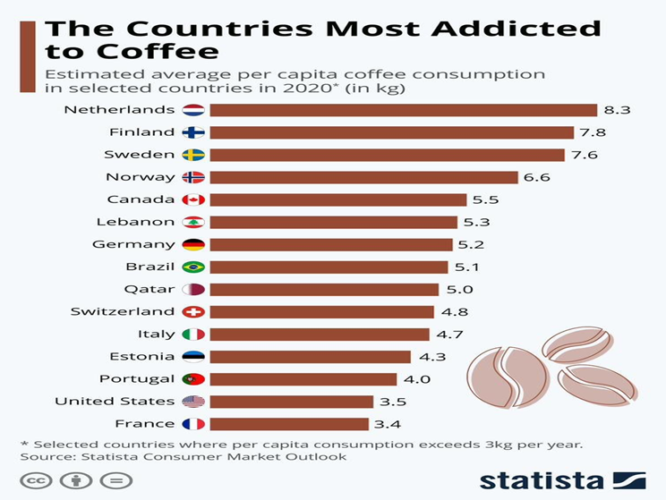
Coffee Consumption
Fig.4

Slide 11
EXAMPLES CONT’D
5. Traffic Congestion:
Traffic congestion is one of the best-known modern examples of the tragedy of the commons. According to a study by the Harvard School of Public Health, air pollution from traffic congestion in urban areas contributes to more than 2,200 premature deaths annually in the United States alone. As more people decide that roads and highways are the fastest way to travel to work, more cars end up on the roads, ultimately slowing down traffic and polluting the air.

Slide 12
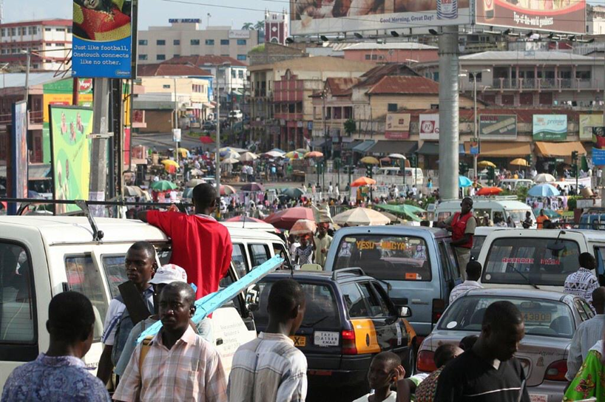
Traffic Consumption(Kumasi)
Fig.5

Slide 13
HOW CAN THE TRAGEDY OF THE COMMONS BE AVOIDED?
The tragedy of the commons can be avoided or mitigated through several approaches:
Establishing clear property rights and regulations
Implementing collective management systems
Creating economic incentives
Encouraging cooperation and communication

Slide 14
CONCLUSION
The tragedy of the commons is relevant to a wide range of real-world issues, including overfishing in the oceans, air pollution, deforestation, and the depletion of natural resources. The conclusion drawn from this concept is that without some form of regulation, cooperation, or governance, shared resources are susceptible to degradation and depletion, leading to a suboptimal outcome for society as a whole.

Slide 15
REFERENCES
The Garrett Hardin Society. Retrieved 2022-11-24.
Thompson, Noel (2004-09-23). "Thompson, William (1775–1833), socialist and economist". Oxford Dictionary of National Biography. Oxford Dictionary of National Biography (online ed.). Oxford University Press. doi:10.1093/ref:odnb/27284. (Subscription or UK public library membership required.)
"Trusts. Powers and Obligations of Trustees. Life Tenant Held Entitled to Net Rents from Each Productive Parcel of Foreclosed Land". Harvard Law Review. 52 (2): 331–332. December 1938. doi:10.2307/1333937. ISSN 0017-811X. JSTOR 1333937

Slide 16
REFERENCES
Shields, Morgan William (2016). "Enhancing insect diversity in agricultural landscapes while providing multiple additional benefits". 2016 International Congress of Entomology. Entomological Society of America. doi:10.1603/ice.2016.111463.
Lloyd, William Forster (1833). Two Lectures on the Checks to Population . Oxford: Oxford University Press. JSTOR 1972412. OL 23458465M – via Wikisource.
Hardin 1968
Zhong, Xianxin; He, Shaotang (1996-07-19). Hoover, Richard B; Walker Ii, Arthur B. C (eds.)High-resolution grazing incidence x-ray spectrometer and its characteristics
Multilayer and Grazing Incidence X-Ray/EUV Optics

Slide 17
GROUP MEMBERS
FOSU-BOATENG ABIGAIL – 9207719
GYASI PHILEMON KUSI – 9208819
KOOMSON NANA AYIPEY – 9211219
BOATENG BERNARD – 9205119
SAMPSON WILLIAM CRONK – 9218719

Slide 18
GROUP MEMBERS
ATTOBRAH ARCHER DERRICK – 9203219
ADWOA GYAMFUA BOAKYE AGYEMANG – 9204719
LEWINSKY NSIAH ASANTE – 9202219
GABSON OSBORN DANIEL – 9208219

